Slide 1
FY19 Changes

Slide 2
FY19 Changes
Victims of Student Violence
Discipline
Position Code Changes
Assessment
How Received/Sent to Codes
Grad Pathways
PBIS
FT Absence Intervention
Miscellaneous

Slide 3
Victim of Student Violence
Victim of Student Violence Record Field Number GD130 Definition Indicates the classification of the person or persons at whom a student’s violent behavior was directed. Valid Options
** The behavior that resulted in the discipline was not violent and/or not directed at another person
ST Directed at Student(s) only
TC Directed at teacher(s) only
NT Directed at non-teaching employee(s) only
OT Directed at other person(s) not considered a student, teacher, or non-teaching employee only
AA Student(s) and teacher(s)
BB Student(s) and non-teaching employee(s)
CC Student(s) and other person(s) not considered a student, teacher, or non-teaching employee
DD Teacher(s) and non-teaching employee(s)
EE Teacher(s) and other person(s) not considered a student, teacher, or non-teaching employee
FF Non-teaching employee(s) and other person(s) not considered a student, teacher, or non- teaching employee
GG All groups except student(s) group
HH All groups except teacher(s) group
JJ All groups except non-teaching employee(s) group
KK All groups except other person(s) group
All groups represented (student(s), teacher(s), non-teaching employee(s), and other person(s) not considered a student, teacher, or non-teaching employee)
This is from an ODE ticket about violence
The victim of student violence should only be reported if it was a violent crime directed at another person(s), 03 Fighting/Violence and 22 Serious Bodily Injury are definite examples where there would be victims of student violence, but there may be others that the district considers to be violent,
'**' - would be reported if the behavior was not directed at another person.
Still waiting on ODE ticket to determine if two students are in a fight are both considered victims of Violence
When released a script will add the victim types at the ITC level and districts will have to map to applicable EMIS victim types—More to come when released.

Slide 4
Pre School to 3 Discipline
Indicates, for students from preschool to grade 3, additional details on why a Type of Discipline of Expulsion or Out-of-school Suspension was assigned for a discipline incident.
Valid Options
* -Not Applicable Student was not in grades PS-3 at the time of the incident, or a type of discipline other than Expulsion or Out-of-school Suspension was assigned.
A - ORC §3313.66(B)(2)-(5)Exemption
Student was in gradesPS-3 at the time of the incident, and Expulsion or Out-of-school Suspension is authorized and was assigned due to student behaviors de-scribed in Ohio Revised Code section 3313.66(B)(2)–(5).

Slide 5
Pre School to 3 Discipline Continued
ORC §3313.66(B)(2)-(5)Exemption
(B)
(2)
(a) Unless a pupil is permanently excluded pursuant to section 3313.662 of the Revised Code, the superintendent of schools of a city, exempted village, or local school district shall expel a pupil from school for a period of one year for bringing a firearm to a school operated by the board of education of the district or onto any other property owned or controlled by the board, except that the superintendent may reduce this requirement on a case-by-case basis in accordance with the policy adopted by the board under section 3313.661 of the Revised Code.
(b) The superintendent of schools of a city, exempted village, or local school district may expel a pupil from school for a period of one year for bringing a firearm to an interscholastic competition, an extracurricular event, or any other school program or activity that is not located in a school or on property that is owned or controlled by the district. The superintendent may reduce this disciplinary action on a case-by-case basis in accordance with the policy adopted by the board under section 3313.661 of the Revised Code.
(c) Any expulsion pursuant to division (B)(2) of this section shall extend, as necessary, into the school year following the school year in which the incident that gives rise to the expulsion takes place. As used in this division, "firearm" has the same meaning as provided pursuant to the "Gun-Free Schools Act," 115 Stat. 1762, 20 U.S.C. 7151.
(3) The board of education of a city, exempted village, or local school district may adopt a resolution authorizing the superintendent of schools to expel a pupil from school for a period not to exceed one year for bringing a knife capable of causing serious bodily injury to a school operated by the board, onto any other property owned or controlled by the board, or to an interscholastic competition, an extracurricular event, or any other program or activity sponsored by the school district or in which the district is a participant, or for possessing a firearm or knife capable of serious bodily injury, at a school, on any other property owned or controlled by the board, or at an interscholastic competition, an extracurricular event, or any other school program or activity, which firearm or knife was initially brought onto school board property by another person. The resolution may authorize the superintendent to extend such an expulsion, as necessary, into the school year following the school year in which the incident that gives rise to the expulsion takes place.
(4) The board of education of a city, exempted village, or local school district may adopt a resolution establishing a policy under section 3313.661 of the Revised Code that authorizes the superintendent of schools to expel a pupil from school for a period not to exceed one year for committing an act that is a criminal offense when committed by an adult and that results in serious physical harm to persons as defined in division (A)(5) of section 2901.01 of the Revised Code or serious physical harm to property as defined in division (A)(6) of section 2901.01 of the Revised Code while the pupil is at school, on any other property owned or controlled by the board, or at an interscholastic competition, an extracurricular event, or any other school program or activity. Any expulsion under this division shall extend, as necessary, into the school year following the school year in which the incident that gives rise to the expulsion takes place.
(5) The board of education of any city, exempted village, or local school district may adopt a resolution establishing a policy under section 3313.661 of the Revised Code that authorizes the superintendent of schools to expel a pupil from school for a period not to exceed one year for making a bomb threat to a school building or to any premises at which a school activity is occurring at the time of the threat. Any expulsion under this division shall extend, as necessary, into the school year following the school year in which the incident that gives rise to the expulsion takes place.

Slide 6
Pre School to 3 Discipline Continued
B - Immediate Health and Safety Exemption Student was in grades PS-3 at the time of the incident, and Expulsion or Out-of-school Suspension was assigned to protect the immediate health and safety of the student, the student's fellow classmates, the classroom staff and teachers, or other school employees
[ORC 3313.668(B)(1)(b) Effective 4/8/2019
(B)
(1) Except as described in division (B) of this section, no school district or school shall issue an out-of-school suspension or expulsion to a student in grades pre-kindergarten through three.
(b) A school district or school may issue an out-of-school suspension not to exceed ten days or an expulsion to a student in any of grades pre-kindergarten through three who has not engaged in any of the behaviors described in divisions (B)(2) to (5) of section 3313.66 of the Revised Code only as necessary to protect the immediate health and safety of the student, the student's fellow classmates, the classroom staff and teachers, or other school employees.

Slide 7
Pre School to 3 Discipline Continued
N - Neither Exemption Applies -Student was in grades PS-3 at the time of the incident, and Expulsion or Out-of-school Suspension was assigned for neither an ORC §3313.66(B)(2)-(5) nor an Immediate Health and Safety Exemption.
There was no indication on the SIAC meeting notes of how or when this would be added.

Slide 8
Discipline Modified Element
If, after due process has been accorded, a student is found to have brought a firearm to school or possessed a firearm at school, the Gun-Free Schools Act requires an expulsion for a period of not less than one year. The law allows the Chief Administrating Officer of the school district to modify the one-year expulsion requirement on a case-by-case basis, but only if the modification is in writing.
Report Y, N or *
Option “* Not Applicable” is to be reported when the Type of Discipline is anything other than 1,(Expulsion) or if the Type of Discipline is 1(Expulsion) and the Discipline Reason is anything other than 06(Use, Possession, Sale or Distribution of a Firearm) and/or 08 (Use, Possession, Sale or Distribution of Any Explosive, Incendiary or Poison Gas)
Report Y or N
If Discipline type is 1 and reason is Y or 8

Slide 9
Discipline Alternative Educational Services Element
Indicates if a student, for whom a Chief Operating Officer modifies as part of a case-by-case basis the one-year expulsion requirement for pro-cession of a firearm was recommended for alternate educational services.
Valid Options
* Not Applicable
Y Yes
N No

Slide 10
Position Codes
Add position code -122 – Dean of Students.
Some Community schools do not have designated Principal, this can be used for those positions or if a school has a Dean of Students but did not have a code to accurately report.
Remove position code-330-Visiting Teacher Assignment

Slide 11
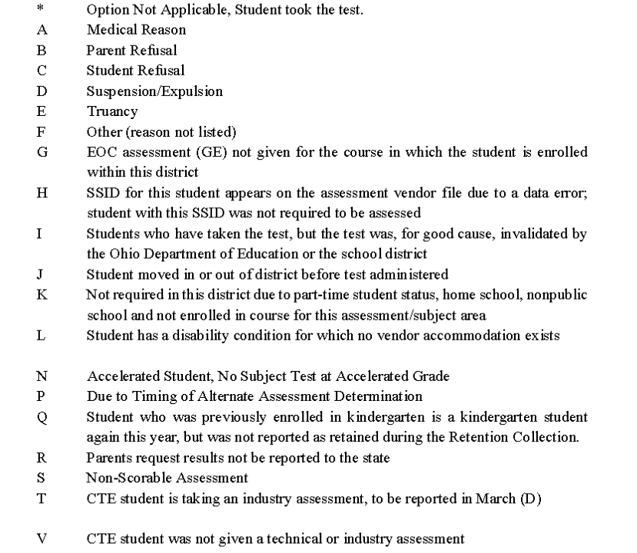
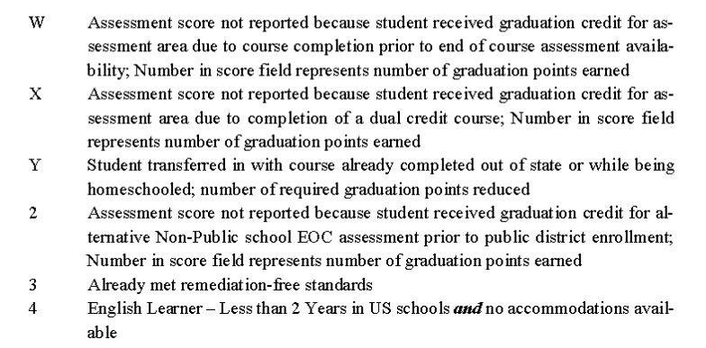
Assessments
Score Not Reported Options

Slide 12
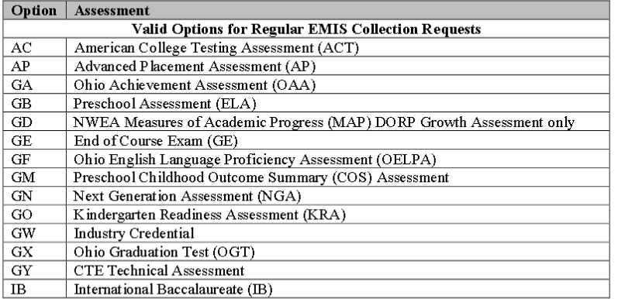
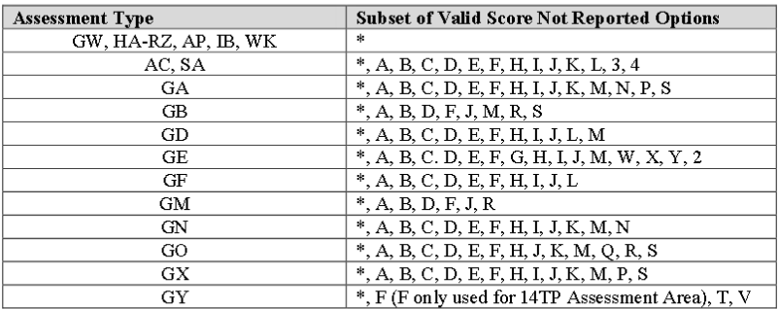
Assessments
Score Not Reported Valid options for each assessment

Slide 13
Assessments
Score Not Reported Options –SNR for EOC Testing
W- Assessment score not reported because student received graduation credit for assessment area due to course completion prior to end of course assessment availability; Number in score field represents number of graduation points earned
X - Assessment score not reported because student received graduation credit for assessment area due to completion of a dual credit course; Number in score field represents number of graduation points earned
Y- Student transferred in with course already completed out of state or while being homeschooled; number of required graduation points reduced. Score is reported with ***
2- Assessment score not reported because student received graduation credit for alternative Non-Public school EOC assessment prior to public district enrollment; Number in score field represents number of graduation points earned
3- Already met remediation-free standards
4- English Learner –Less than 2 Years in US schools and no accommodations available
5- Student assessed but the results not available from assessment vendor by close of reporting window

Slide 14
Assessments
Military Transfer Students
Military Compact Graduation Alternative Count Element
Students who are identified under the Military Compact, per Section 3301.60of the Ohio Revised Code, may be exempt from Ohio’s graduation assessment requirements if they can prove they met his/her former state’s graduation assessment requirements. For additional information on this student population, search from any ODE webpage for “Military Compact.”
This element has been changed from 5 to 7.
You can report a SNR of Y in the assessments for the courses completed out of state which reduces the grad points required but in some cases there is still the rule that they need to take specific tests. If they are military students, then you would report the number of tests that they do not need to take.
College Credit Plus (CCP) courses or approved AP/IB tests, in the subject area, will satisfy the end-of-course graduation test requirement for American history, American government, physical science (class of 2018 only) and biology. The college course grade earned under College Credit Plus or AP/IB test score may earn graduation points in place of the end-of-course tests as provided here.
It is important to note, while students can earn graduation points for CCP coursework and AP/IB test scores in biology, all schools must administer the biology end-of-course tests to all students in order to satisfy federal testing requirements. CCP students may use their course grade and AP/IB students may use their test scores OR the biology end-of-course test score to earn graduation points, whichever is higher. A student completing a CCP course in American history or American government will not need to sit for the end-of-course tests in the subject area and may earn graduation points based on the letter grade in the course.
There are no CCP/AP/IB substitutions for mathematics or English language arts. Students may use math and English language arts CCP/AP/IB courses to satisfy the graduation curriculum requirements. But schools must administer the end-of-course tests to students to earn graduation points.

Slide 15
How Received/Sent to Codes Traditional Districts
How received of D- count placed non foster student
EMIS situation 610 Full time in your district
EMIS situation 613-On to a 3rd district(CPP JVS)
How Received of J – Non-Foster student placed under program of the county children and family services department without court involvement.
EMIS situation of 612 for student full time in your district.
EMIS Situation of 615 for a student that attends another district (JVS, CCP)
Sent to CO- Court placed out of state leas is responsible for paying cost of education.
EMIS situation 614
Sent to % of time =0
Sent to IRN =999999
How received of G- EMIS situation 611
District A= Resident District
District B= Foster Placed District
District C= OE District.
If you need to report a student in this situation that also attend you will need to use EMIS situation 90. It will allow you to report the student Part or Full time to the JVS or to CCP
ODE indicated in the EMIS call on Monday that district B if they are already reporting the student can leave the student in, ODE will not look at what District B is reporting. It was asked if they could be withdrawn with an 81 and he said that would be ok.

Slide 16
How Received/Sent to Codes Traditional Districts
This is from an ODE ticket that was sent for Wilmington
Wilmington has a student that is a resident, put on a Safety Plan placing them in Blanchester but is remaining at Wilmington- the resident district. How would we code that student?
They also have a Resident student again placed on a safety plan in Clinton Massie, staying at Wlimington but also enrolled in a satellite class at Wilmington.
Hi Karen,
Since these are not foster placements, the students are not automatically entitled to stay at the resident district like they are in foster situations. Therefore, Wilmington would need to open-enroll the students or have a superintendent's agreement. The satellite class would be reported by the JVSD with Wilmington as the DOR and Blanchester as the received from IRN.
Thanks, Bill
I have added a new question to the ticket regarding Safety Plan students and homeless and how that all plays into things. More to come!

Slide 17
How Received/Sent to Codes Community Schools and JVSDs
Community Schools
How Received of D- court placed non foster student
EMIS situation of 617 Non-resident court placed non foster
How Received of J- Non Foster placed under county program attending Community School
EMIS Situation of 616 -Non-foster placed under county program attending a community school.
JVSDs
How received of D- count placed non foster student
EMIS situation 618 – student attending JVS
EMIS situation 620 Non-Resident court placed non-foster attending the JVS and CCP
How Received of J – Non-Foster student placed under program of the county children and family services department without court involvement.
EMIS situation of 619 for student full time in your district.
EMIS Situation 621- Non resident non-foster placed by county program onto CCP

Slide 18
Graduation Pathways 2019 Option 1
Option 1 – Available to all students in the classes of 2018 and 2019.
Students entering grade 9 between July 1, 2014, and June 30, 2016, are eligible to utilize the graduation options outlined below.
Students must take and pass courses that constitute the curriculum requirements and take all seven end-of-course exams. If the student receives a score of “1” or “2” on any math or English language arts test, the student must retake the test at least once while in high school.
Additionally, students must meet at least two of the below requirements:
Attendance rate of 93 percent during the 12th-grade year;
Earn a GPA of 2.5 on a 4.0 scale in all courses completed during 12th grade (must complete at least four full-year, or equivalent, courses);
Complete a capstone project during 12th grade that the district or school defines;
During 12th grade, complete a work or community service experience totaling 120 hours that the district or school defines;
Earn three or more College Credit Plus credits at any time during high school;
Earn credit for an Advanced Placement (AP) or International Baccalaureate (IB) course and earn an AP exam score of 3 or higher or IB exam score of 4 or higher at any time during high school;
Earn a WorkKeys exam score of 3 on each of three test sections;
Earn a State Board-approved industry-recognized credential or credentials that equal at least three points;
Meet OhioMeansJobs Readiness Seal requirements.

Slide 19
Graduation Pathways 2019 Option 2
Option 2 – Available to students in the classes of 2018 and 2019 in career-technical programs.
Students must take and pass courses that constitute the curriculum requirements and take all seven end-of-course exams. Students must finish a career-technical program that includes at least four courses in a single career pathway and complete at least one of the options below:
Earn a total score of Proficient or better based on all career-technical exams or test modules;
Earn an industry-recognized credential or credentials that equal 12 points;
Complete a workplace experience totaling 250 hours with evidence of positive evaluations.

Slide 20
Graduation Pathways 2020 Option 1
Students entering grade 9 between July 1, 2016, and June 30, 2017, are eligible to utilize the modified graduation options below.
Students must take and pass courses that constitute the curriculum requirements and take all seven end-of-course exams. If the student receives a score of “1” or “2” on any math or English language arts test, the student must retake the test at least once.
Additionally, students must meet at least two of the below requirements:
Earn a GPA of 2.5 on a 4.0 scale in all courses completed during the 11th and 12th grades (must complete at least four full-year – or equivalent – courses in each year);
Complete a capstone project during 12th grade that meets criteria defined by Ohio Department of Education guidance and evaluation processes (guidance available by May 31, 2019);
During 12th grade, complete a work or community service experience totaling 120 hours, as defined by the Ohio Department of Education (guidance available by May 31, 2019);
Earn three or more College Credit Plus credits at any time during high school;
Earn credit for an Advanced Placement (AP) or International Baccalaureate (IB) course and earn an AP exam score of 3 or higher or IB exam score of 4 or higher at any time during high school;
Earn a WorkKeys exam score of 3 on each of three test sections;
Earn a State Board-approved industry-recognized credential or credentials that equal at least three points;
New program code will be added.

Slide 21
Graduation Pathways 2020 Option 2
Option 2 – Available to students in the class of 2020 in career-technical programs.
Students entering grade 9 between July 1, 2016, and June 30, 2017, who are enrolled in career-technical education programs are eligible to utilize the modified graduation options below.
Students must take and pass courses that constitute the curriculum requirements and take all seven end-of-course exams. Students must finish a career-technical program that includes at least four courses in a single career pathway and complete at least one of the options below:
Earn a total score of Proficient or better based on all career-technical exams or test modules;
Earn an industry-recognized credential or credentials that equal 12 points;
Complete a workplace experience totaling 250 hours with evidence of positive evaluations.

Slide 22
Positive Behavioral Interventions and Supports (PBIS)
When an LEA reports an Attribute Name, they also report an Organization IRN, Date, Text, and Number for that attribute. n an LEA reports an Attribute Name, they also report an Organization IRN, Date, Text, and Number for that attribute.
The Organization IRN would be the Building IRN being reported
The Attribute Date would be reported as the default 00000000 since no date applies to this attribute
The Attribute Text would be reported as a letter reflecting the stage of implementation for Building
The Attribute Number would be reported as the number of months the building has been in the reported stage of PBIS implementation

Slide 23
FT/Absence Intervention updates Anticipated to be in 18.9
Adding new section to absence intervention page to allow manual entry of FT event records – right now they enter directly into flat file transfer; this will be used for tracking students who have had absences before coming to your district so habitual truancy thresholds will be recognized
Absence intervention page will show absence hours from all entities for a student – adding a tab/link that will show hours for home school & other entity if there is a district trust setup. This will not generate events, those will have to be manually entered.
Flag for satellite students for HB410 will be checked by default based on EMIS situation when installed only at home school or community school. If they DO mark kids as satellite at a JVS they will be calculated as 100% for HB410 so discourage them from flagging ‘is satellite’ at JVS.
Attendance calculation will support the new flag & calculate those students as 100%. EMIS calculations will still use the student percent of time.
If these changes do not come in prior to the end of the year we will have another meeting on how to report the data in the FFE.

Slide 24
Miscellaneous Items
DASL will be disabling HQT checks
PreSchool Poverty level J added for students that are in an ECE that are in court ordered protective custody
ODE is removing the Previous Dropout Program Codes
Add and Delete some LEP program codes
Add Work Based Learning program codes by hours of completion ranges.
Will require a Staff ID
Adding Retention Reason N for TGRG- Students that took the iReady test and met adequate progress prior to the beginning of the next school year.
ODE will be adding New Program codes for CTSO
CTSO Leadership
Intern
Apprentice
Fall Initialization
Discussion on whether to run and updating Checkboxes.
Blizzard Bag-Ebag days
Leave the day as an attending day on the master calendar
If you have already changed it to be a non-attending day change it back to an attending day
Add an EMIS exception for calamity day taken put in 0.0 hours
Add another EMIS exception of blizzard bag day and add the number of school hours to count toward attendance

Slide 25
Open Discussion and Questions

